Slide 1
NURSERY SYSTEM
1 : Panchal Dhrumil Vinay Bhai [196330307056]
2 : Oza Dev Daxesh [196330307052]
3: Raval Jeet Nitinkumar [196330307100]
4 : Moolya Swastik Bhoja [196330307524]

Slide 2
CHAPTER-1 INTRODUCTION

Slide 3
Need of the new system
In present era, the importance of Nursery Store is growing up day by day, user needs a simple interface to order Plants online, this project Online Nursery Store fulfills all the requirements of user and it provides an easy interface to navigate.
This Online Nursery Store allows the user to select the desired Plants from a list of available menu items.
We have simplified the flow of Plants ordering in this project, so if a person wants to buy Plants then he can easily order online on some clicks only. Also, we have implemented filters so customer can choose category from Nursery, Type etc.

Slide 4
The customer can easily place orders for the Plants items of their choice. For ordering the Plants customer needs to register into the system with their dtails and after the registration, customer can filter out the Plants according to the Nursery, Type user will add the Plants into the cart and make order.

Slide 5
Detailed problem definition
In this system, we have developed an approach to allow customers to buy plants without even visiting shop.
Being able to buy anytime, anywhere, any place.
Site enables them to browse before they shop, and to research the product so they have more confidence in what they are buying.
Online shopping becomes more enjoyable and easier than real- world shopping.
It provides Cash On Delivery facility.
Customer can track their order detail and give the rating according to his experience.

Slide 6
Viability of the system
This system can easily understand and use it.
Plant details will also provide.
Online payment also will be provide.
Customer rating section.
The proposed system can guarantee to keep the records are safe and privacy which is stored in the database.

Slide 7
Presently available system for the same
https://www.santhionlineplants.com/
In this system there is no any detailed rating of product.
Lack of Choices.
There is no option for vases (pots/planters).
There are no any facilities for plantation tools, fertilizers, take care tips, pesticides.

Slide 8
Future Prospect
Number of shopkeeper’s can register to the web portal for increase their sale.
Hire Expert of gardening.
This application can be used by any user to purchase the online plants and get appropriate information by viewing short summery about the plants items through videos.
If any changes to make customer can purchase the plants through different payment schemes like debit card, credit card, pat, phone pay, cash on delivery etc.

Slide 9
CHAPTER-2 ANALYSIS

Slide 10
Requirement Analysis
In present era, the importance of Online Nursery Store is growing up day by day, user needs a simple interface to order Plants online, this project Online Nursery Store fulfills all the requirements of user and it provides an easy interface to navigate.
The customer can easily place orders for the Plants items of their choice. For ordering the Plants customer needs to register into the system with their details and after the registration, customer can filter out the Plants according to the Nursery, Type, Company, he will add the Plants into the cart and make payment.

Slide 11
Project Model
When errors are detected at some later phase, these feedback paths allow correcting errors committed by programmers during some phase. The feedback paths allow the phase to be reworked in which errors are committed and these changes are reflected in the later phases. But, there is no feedback path to the stage – feasibility study, because once a project has been taken, does not give- up the project easily.
It is good to detect errors in the same phase in which they are committed. It reduces the effort and time required to correct the errors.
User can also give feedback, rating and can upload product images and it provides easy return policy if there any problem.

Slide 12
Phase Containment of Errors: The principle of detecting errors as close to their points of commitment as possible is known as Phase containment of errors.

Slide 13
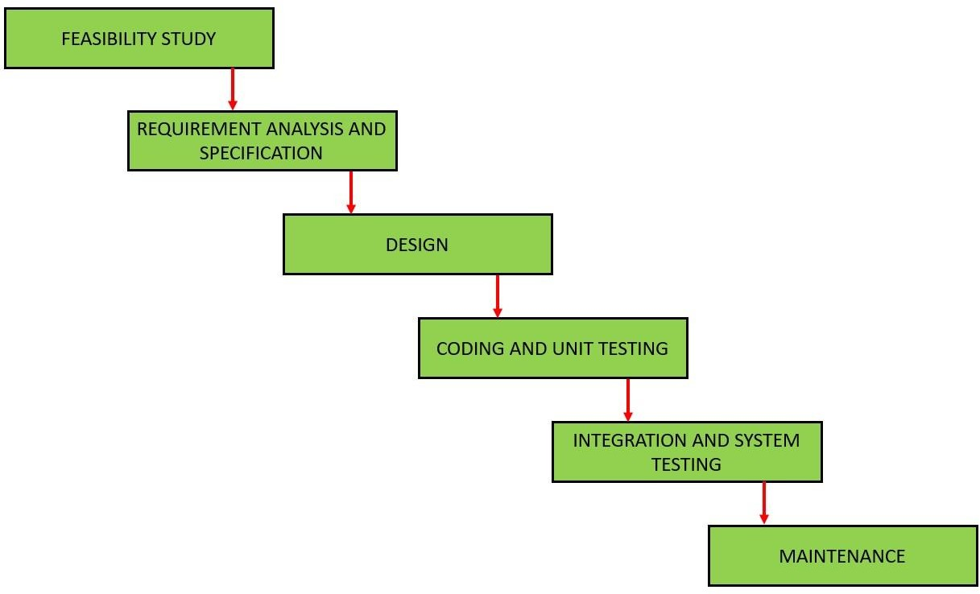

Slide 14
Advantages of iterative waterfall model
Feedback Path: In the classical waterfall model, there are no feedback paths, so there is no mechanism for error correction. But in iterative
Simple: Iterative waterfall model is very simple to understand and use. That’s why it is one of the most widely used software development models.
User gets a chance to experiment with partially developed software.
This model helps finding exact user requirements.
Feedback providing at each increment is useful for determining the better final product.

Slide 15
Schedule Representation
Generalized project scheduling tools and technique can be applied with little modification to software projects.
Program evolution and review techniques (PERT) and critical path method (CPM) are two project scheduling method that can be applied to software development. Both techniques are driven by information already developed in earlier project planning activities:
Estimate of effort.
A decomposition of the product function.
The selection of appropriate process model and task set.
Decomposition of tasks.

Slide 16
Feasibility Study

Slide 17
Technical Feasibility
The system is self-explanting and does not need any entire sophisticated training. A system has been built by concentrating on the graphical user interface concepts, the website can also be handled very easily with a novice uses. The overall time that a user needs to get trained is less than 15 minutes. The system has been added with features of menu device and button interaction methods, which makes him the master as he starts working through the environment. As the software that were used as developing this application are very economical and are readily available is the market the only time that is lost by the customer is just installation time.

Slide 18
Economical Feasibility
To produce an ecommerce website requires a high-speed connection to the Internet, a web server, and software. Other costs that are relevant is the cost of the payment system, whether it is taking online payment directly from the society’s web site or an alternative third-party like Pay pal or more expensively using an online bank.
It refers to the benefits or outcomes we are deriving from the product as compared to the total cost we are spending for developing the benefits are more or less the same as the older system then it is not feasible to develop the product. The product is economical feasible. It will provide following benefits:
Reduces the processing time
Reduces the work load
Administrative will be effective

Slide 19
Operational Feasibility
It refers to the feasibility of the product to be operational. Some products may work very well at the design and implementation but many fail in the real time environment. It introduces the study of human resources required and their technical expertise. This product is operationally feasible as it is designed specifically for E-Nursery. This provides consistent and integrated data management. It also provides information at all levels of people.

Slide 20
CHAPTER 3 DESIGN

Slide 21
Data flow diagram
DFD (data flow diagram) is also known as bubble chart or data flow graph. DFD’s are very useful in understanding the system and can be effectively used during analysis. It shows flow of data through a system visually. The DFD is a hierarchical graphical model of a system the different processing activities or functions that the system performs and the data interchange among these functions. It views a system as a function that transforms the inputs into desired output. Each function is considered as a process that consumes some input data and produces some output data. Function model can be represented using DFD.

Slide 22
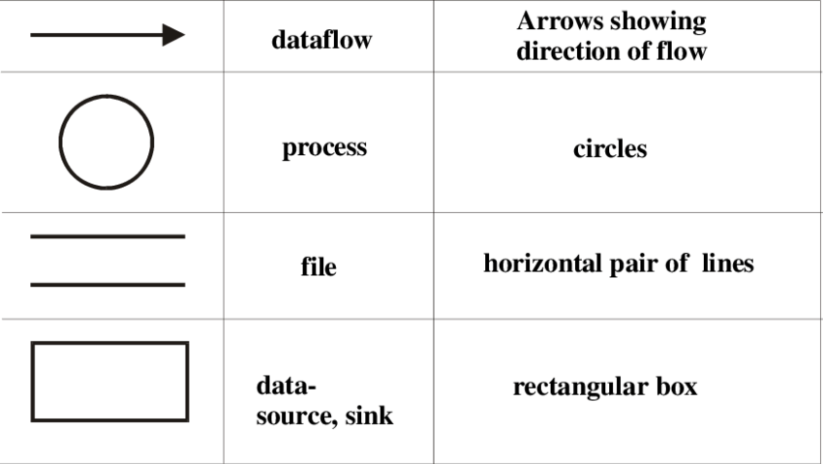

Slide 23
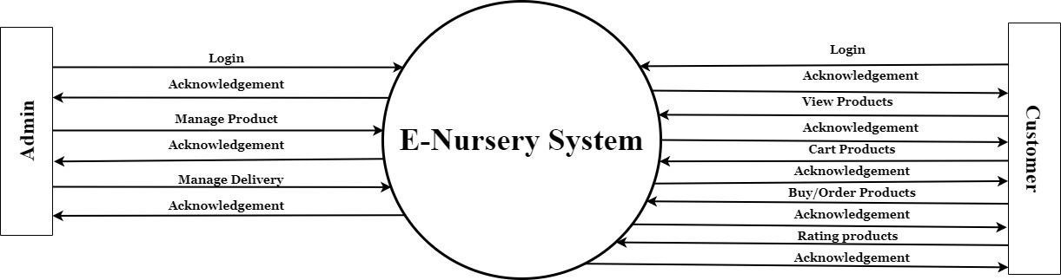
DFD Context level-0

Slide 24
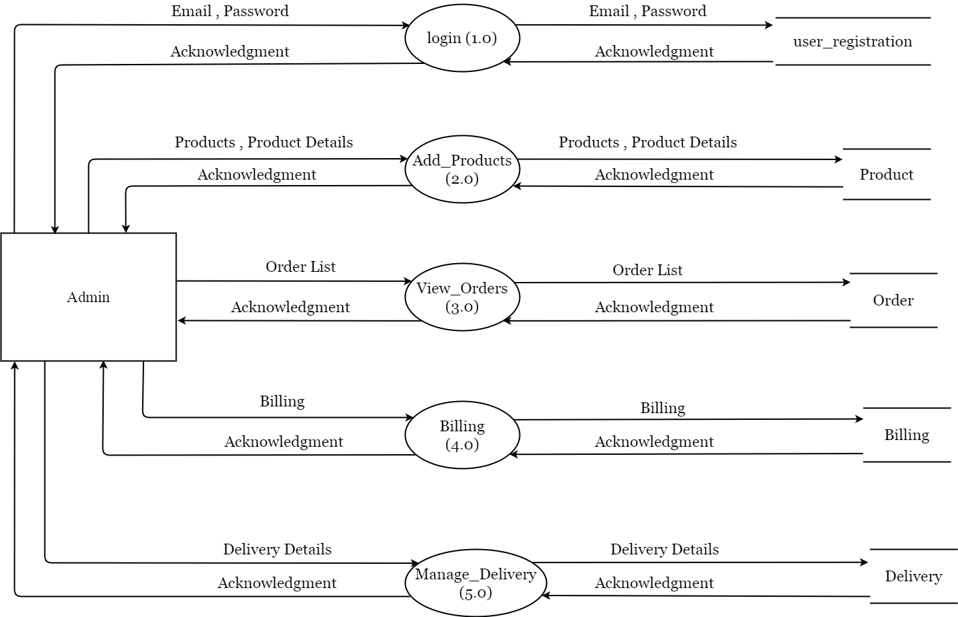
DFD 2: Level-Admin

Slide 25
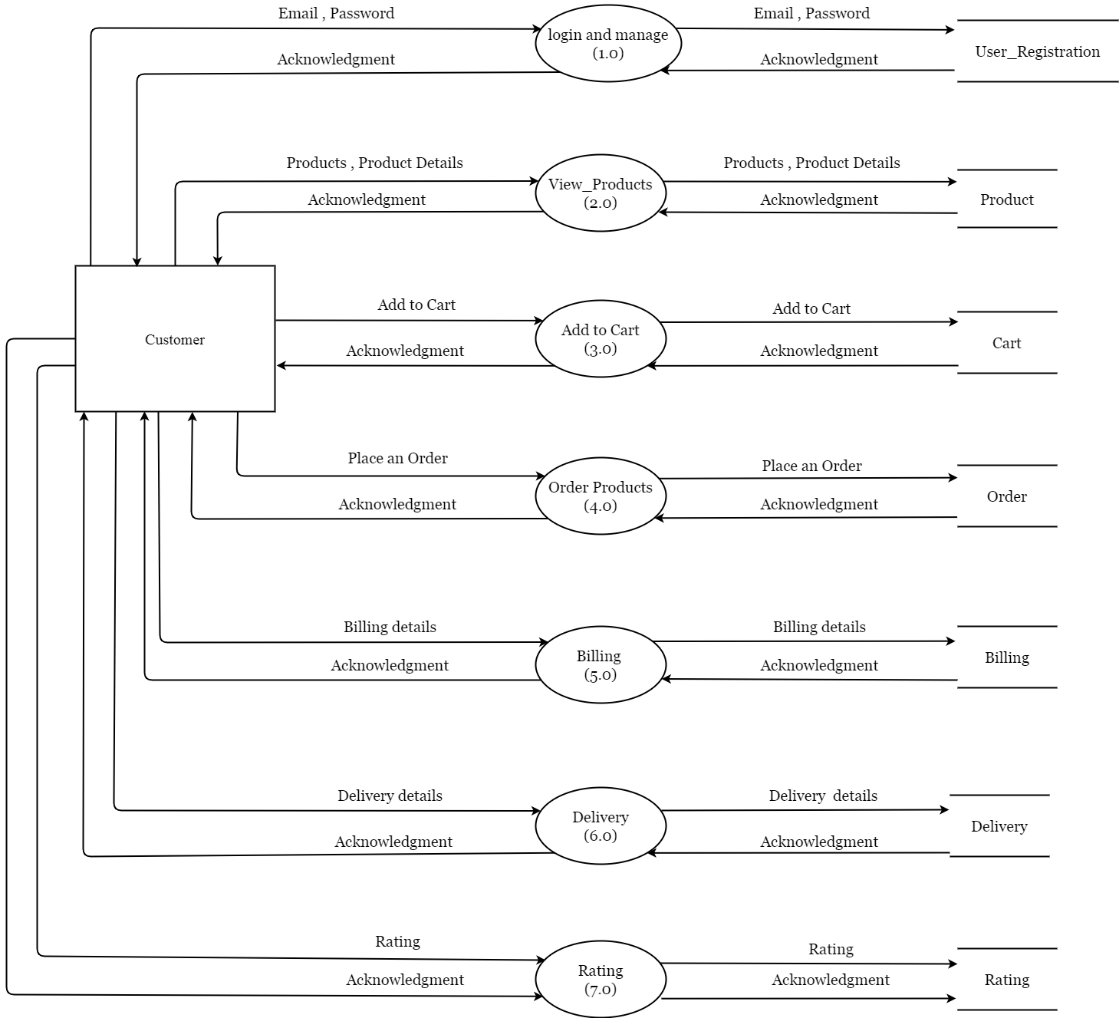
DFD 3: Level-Customer

Slide 26
ER-Diagram
An Entity Relationship (ER) Diagram is a type of flowchart that illustrates how “entities” such as people, objects or concepts relate to each other within a system. ER Diagrams are most often used to design or debug relational databases in the fields of software engineering, business information systems, education and research. Also known as ERDs or ER Models, they use a defined set of symbols such as rectangles, diamonds, ovals and connecting lines to depict the interconnectedness of entities, relationships and their attributes. They mirror grammatical structure, with entities as nouns and relationships as verbs.

Slide 27
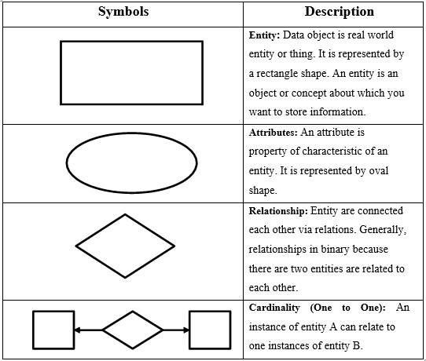
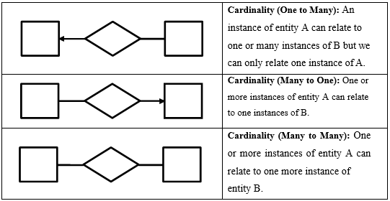

Slide 28
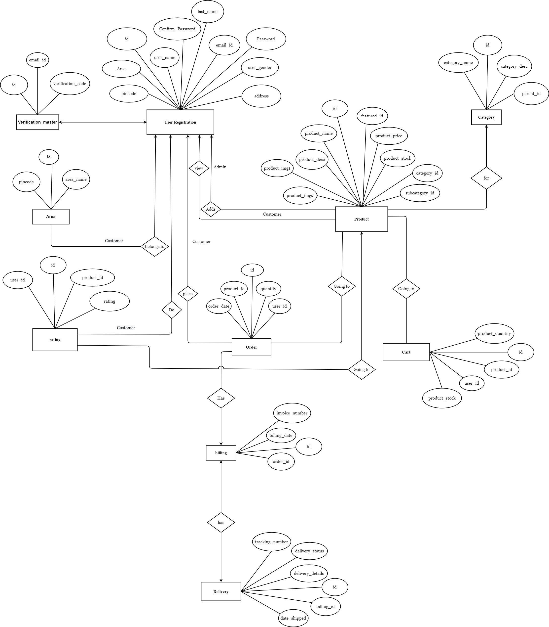

Slide 29
CHAPTER-4 SYSTEM MODELING

Slide 30
Database dictionary

Slide 31
1. Table name: User_registration Primary key: user_id
SR.NO | FIELDNAME | DATATYPE(SIZE) | CONSTRAINT | DESCRIPTION
1 | id | Int(10) | Primary key | User’s id
2 | user_name | Varchar(20) | Not null | User’s First name
3 | email_id | Varchar(30) | Unique | User’s email id
4 | password | Varchar(20) | Not null | User’s password
5 | confirm_password | Varchar(20) | Not null | User’s password
6 | phone_number | BigInt(12) | Not null | User’s number
7 | area | Varchar(20) | Not null | User’s area
8 | address | Varchar(150) | Not null | User’s address
9 | pincode | Int(6) | Not null | User’s pincode
10 | user_gender | Varchar(20) | Not null | User’s gender

Slide 32
2. Table name: Product Primary key: product_id
SR.NO | FIELDNAME | DATATYPE(SIZE) | CONSTRAINT | DESCRIPTION
1 | id | Int(10) | Primary key | Product id
2 | product_name | Varchar(50) | Not null | Product name
3 | product_desc | Varchar(250) | Not null | Product description
4 | product_img1 | Varchar(40) | Not null | Product image 1
5 | product_img2 | Varchar(40) | Not null | Product image 2
6 | product_price | Int(6) | Not null | Product price
7 | product_stock | Int(4) | Not null | Product’s stock
8 | category_id | Int(10) | Foreign key | Category id
9 | sub_category_id | Int(6) | Foreign key | Product’s subcategory
10 | featured_id | TinyInt(2) | Default 0 | Product featured

Slide 33
3. Table name: Category Primary key: category_id
SR.NO | FIELDNAME | DATATYPE(SIZE) | CONSTRAINT | DESCRIPTION
1 | id | Int(10) | Primary key | Category id
2 | category_name | Varchar(50) | Not null | Category name
3 | category_desc | Varchar(100) | Not null | Category description
4 | parent_id | Int(10) | Default 0 | Parent id

Slide 34
4. Table name: Area Primary key: area_id
SR.NO | FIELDNAME | DATATYPE(SIZE) | CONSTRAINT | DESCRIPTION
1 | id | Int(10) | Primary key | Area
2 | area_name | Varchar(30) | Not null | Area name
3 | pincode | Int(6) | Not null | Area pincode

Slide 35
5. Table name: Verification_master Primary key: id
SR.NO | FIELD NAME | DATATYPE(SIZE) | CONSTRAINT | DESCRIPTION
1 | id | Int(10) | Primary key | id
2 | email_id | Varchar(30) | Foreign key | Email id
3 | verification_code | Varchar(20) | Unique | Verification code

Slide 36
6 6. Table name: Rating Primary key: rating_id
SR.NO | FIELD NAME | DATATYPE(SIZE) | CONSTRAINT | DESCRIPTION
1 | id | Int(10) | Primary key | Rating id
2 | user_id | Int(10) | Foreign key | User’s id
3 | product_id | Int(10) | Foreign key | Product’s id
4 | rating | enum('1', '2', '3', '4', '5') | Not null | Rating

Slide 37
7. Table name: Cart Primary key: cart_id
SR.NO | FIELD NAME | DATATYPE(SIZE) | CONSTRAINT | DESCRIPTION
1 | id | Int(10) | Primary key | Cart id
2 | user_id | Int(10) | Foreign key | User’s id
3 | product_id | Int(10) | Foreign key | Product’s id
4 | product_stock | Int(10) | Not null | Product’s stock
5 | product_quantity | Int(10) | Not null | Product’s quantity

Slide 38
8. Table name: Order Primary key: order_id
SR.NO | FIELDNAME | DATATYPE(SIZE) | CONSTRAINT | DESCRIPTION
1 | id | Int(10) | Primary key | Order id
2 | user_id | Int(10) | Foreign key | User’s id
3 | product_id | Int(10) | Foreign key | Product’s id
4 | quantity | Int(6) | Not null | Quantity
5 | order_date | Date | Not null | Order date

Slide 39
9. Table name: Billing Primary key: billing_id
SR.NO | FIELDNAME | DATATYPE(SIZE) | CONSTRAINT | DESCRIPTION
1 | id | Int(10) | Primary key | Billing id
2 | order_id | Int(10) | Foreign key | Order id
3 | invoice_number | Int(10) | Unique | Invoice number
4 | billing_date | Date | Not null | Billing date

Slide 40
10. Table name: Delivery Primary key: delivery_id
SR.NO | FIELDNAME | DATATYPE(SIZE) | CONSTRAINT | DESCRIPTION
1 | id | Int(10) | Primary key | Delivery id
2 | billing_id | Int(10) | Foreign key | Billing id
3 | tracking_number | Varchar(10) | Unique | Tracking number
4 | date_shipped | Date | Not null | Date Shipped
5 | delivery_status | TinyInt(1) | Not null | Delivery status
6 | delivery_details | Varchar(150) | Not null | Delivery details

Slide 41
Technical Specification
IDE : Sublime Text
Frontend : HTML and CSS , Javascript
Backend : PHP , MySQL

Slide 42
Proposed Systems
Overcomed Functionalities :
1 : In Proposed System we will provide vast Options For Plants like Placements , in Placement For Bedroom , kitchen , Office , desk ,temple etc . Occasions , Like birthday , anniversary , environment day etc , Festivals .
2 : Review of product (plant) is available here (oxygen release level , its type etc .
3: we will provide many types vases (pot/planters) like metallic planters , ART planters , wooden planters , Ceramic planters , self watering pots .
4 : in proposed system we will also include Gardening tool section , where plantation tools are available .
5 : we will also include section for fertilizers and seeds .

Slide 43

Modules
Customer Management

Slide 44


Modules
Products Management

Slide 45


Functionalities
3 : Customer Rating Section

